Slide 1
Gen AI Visionaries 2025,
A Case Study Competition by IIM Mumbai
Team Name: Fintech Mavericks
Team Members: Nithin G, Siddesh Sharma, Syed Shahbuddin and Utsav Soni
Problem Statement: Detection of Answers and Nonanswers from earning call transcripts.

Slide 2
Objective
Fine-tune a LLM to classify earnings call responses as "Answer" or "Nonanswer” and reasoning to it.
Improve accuracy in financial text classification.
Automate filtering of informative vs. vague statements.
Optimize a pre-trained model (GPT-2) for financial Q&A.
Justify the classification by Reasoning.
Deploy for applications in sentiment analysis and financial insights.

Slide 3
Dataset
The given dataset had imbalance in no. of answers and nonanswers.
Hence Synthetic Generated data from an LLM was used to balance it.
Label Distribution:
Answer (1) – Responses that provide specific, quantifiable information.
Nonanswer (0) – Vague or evasive responses without actionable details.
Dataset Overview:
Total Samples: 1,740
Class Distribution (After Augmentation):
Answer: 903 samples
Nonanswer: 834 samples

Slide 4
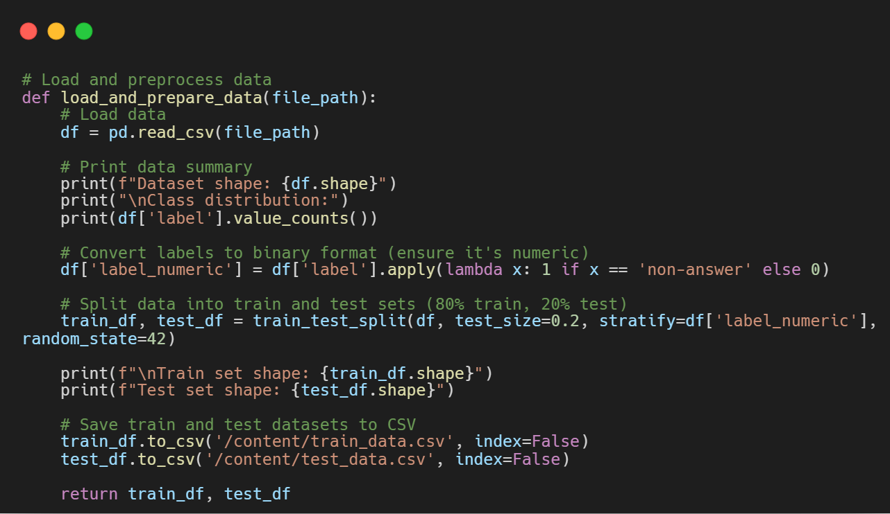
Preprocessing Data
Converted labels to binary format (Answer = 0, Non-Answer = 1).
Performed train-test split (80% train, 20% test) with stratification.
Tokenized text data using a transformer-based tokenizer.

Slide 5
Fine-Tuning
Model Used: GPT-2 (openai-community/gpt2) for classification.
Tokenizer: AutoTokenizer with padding set to eos_token.
Dataset: Tokenized text data with binary labels (Answer = 0, Non-Answer = 1).
Training Setup: Hugging Face Trainer with AdamW optimizer and fp16 for mixed precision.
Hyperparameters: Learning rate, batch size, weight decay, and training epochs optimized.
Evaluation Metrics: Accuracy, Precision, Recall, and F1-score for model performance.
Pretrained Weights: Initialized from Hugging Face and fine-tuned on the dataset.

Slide 6
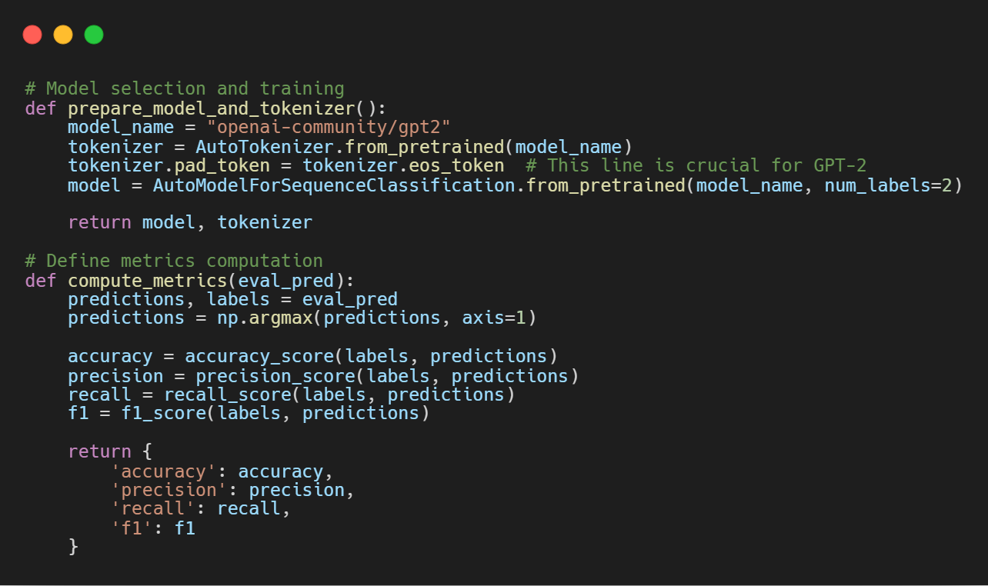

Slide 7
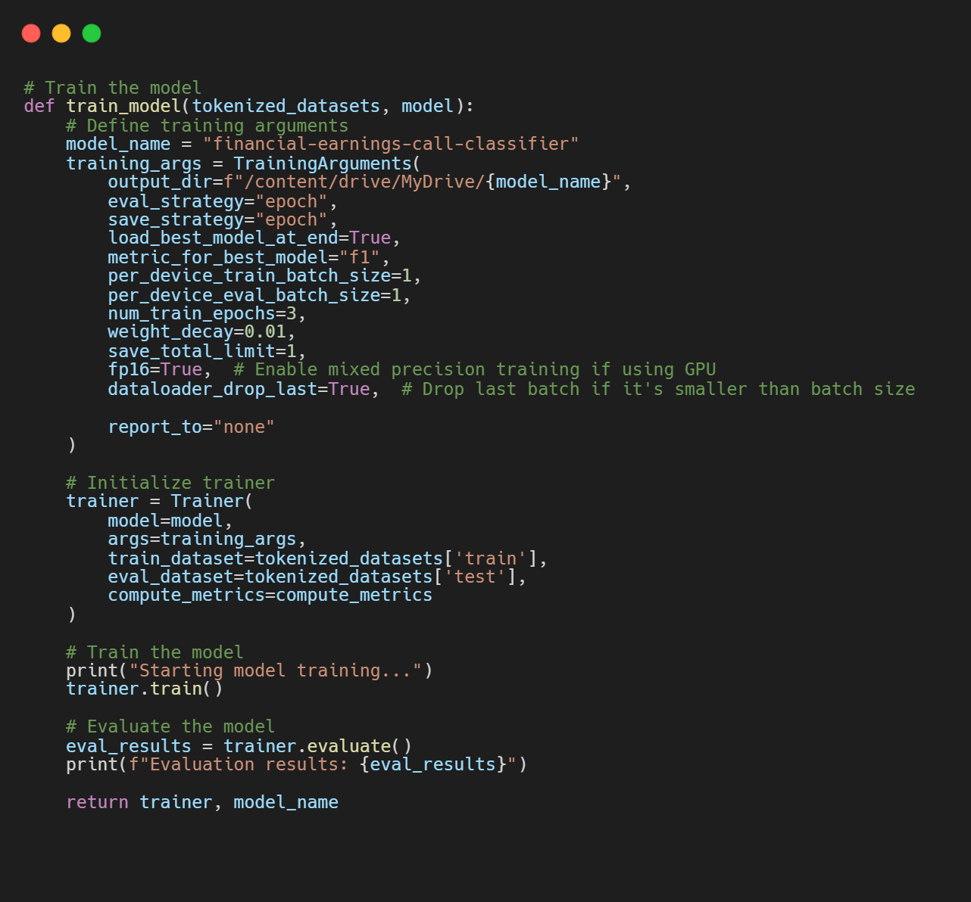
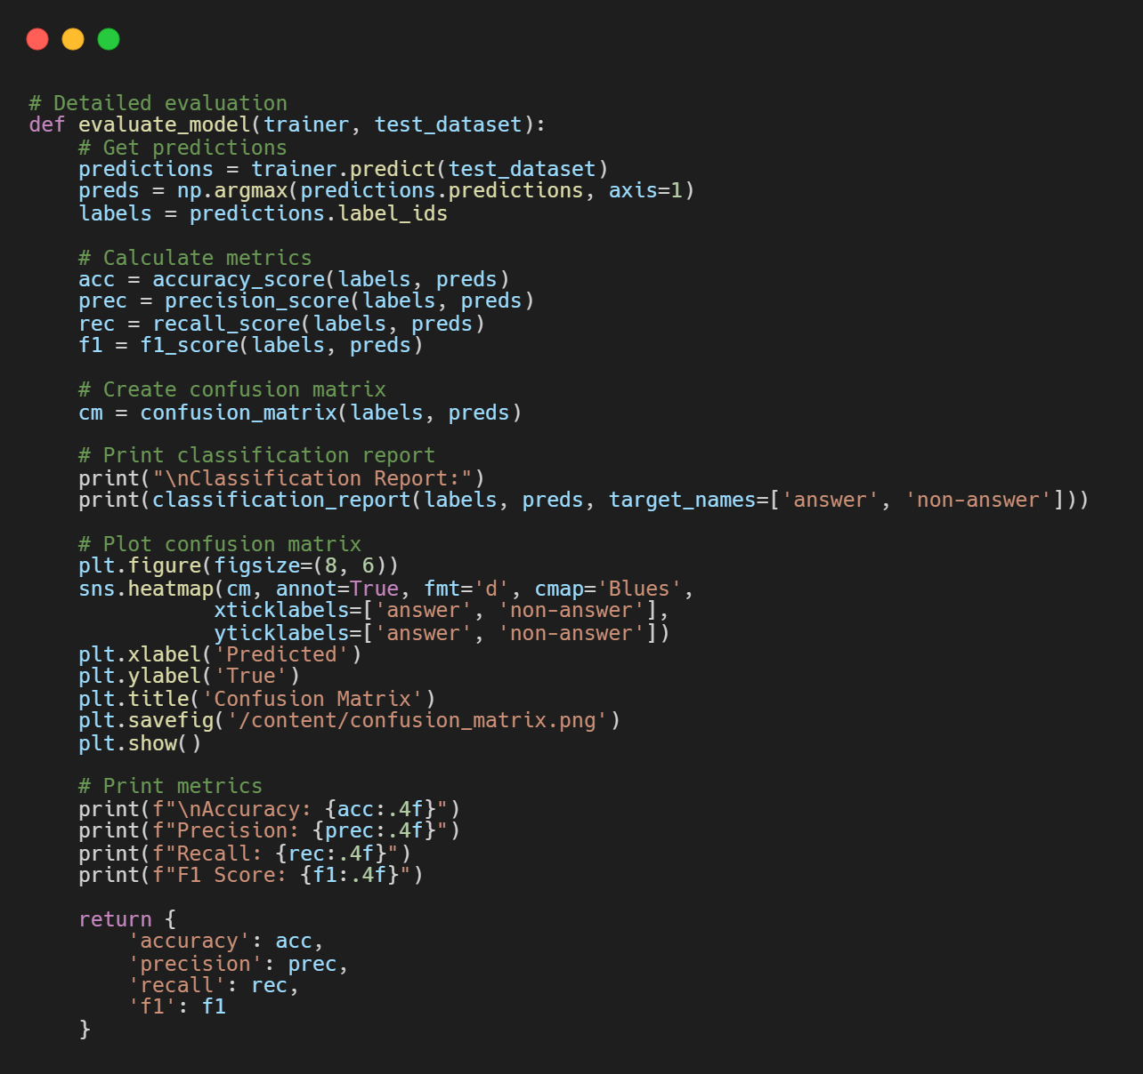

Slide 8
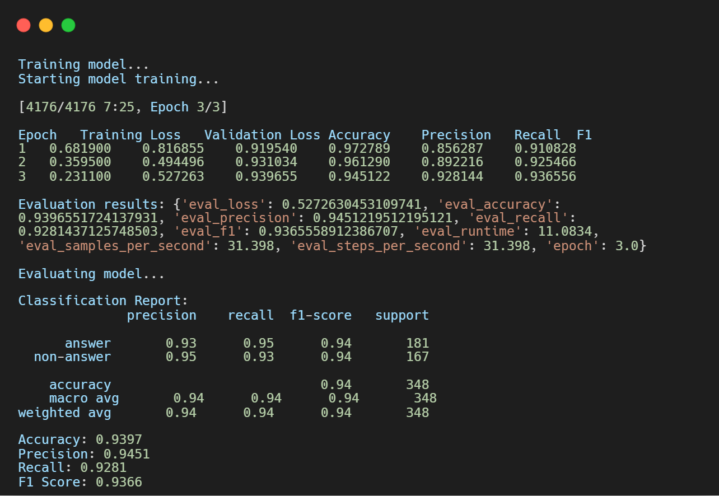
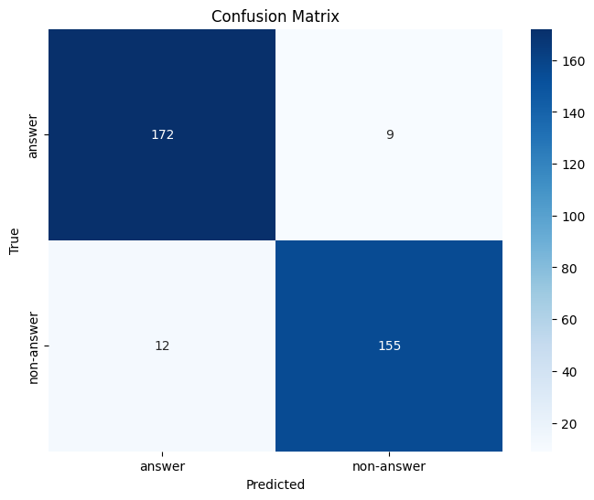
Classification Result

Slide 9
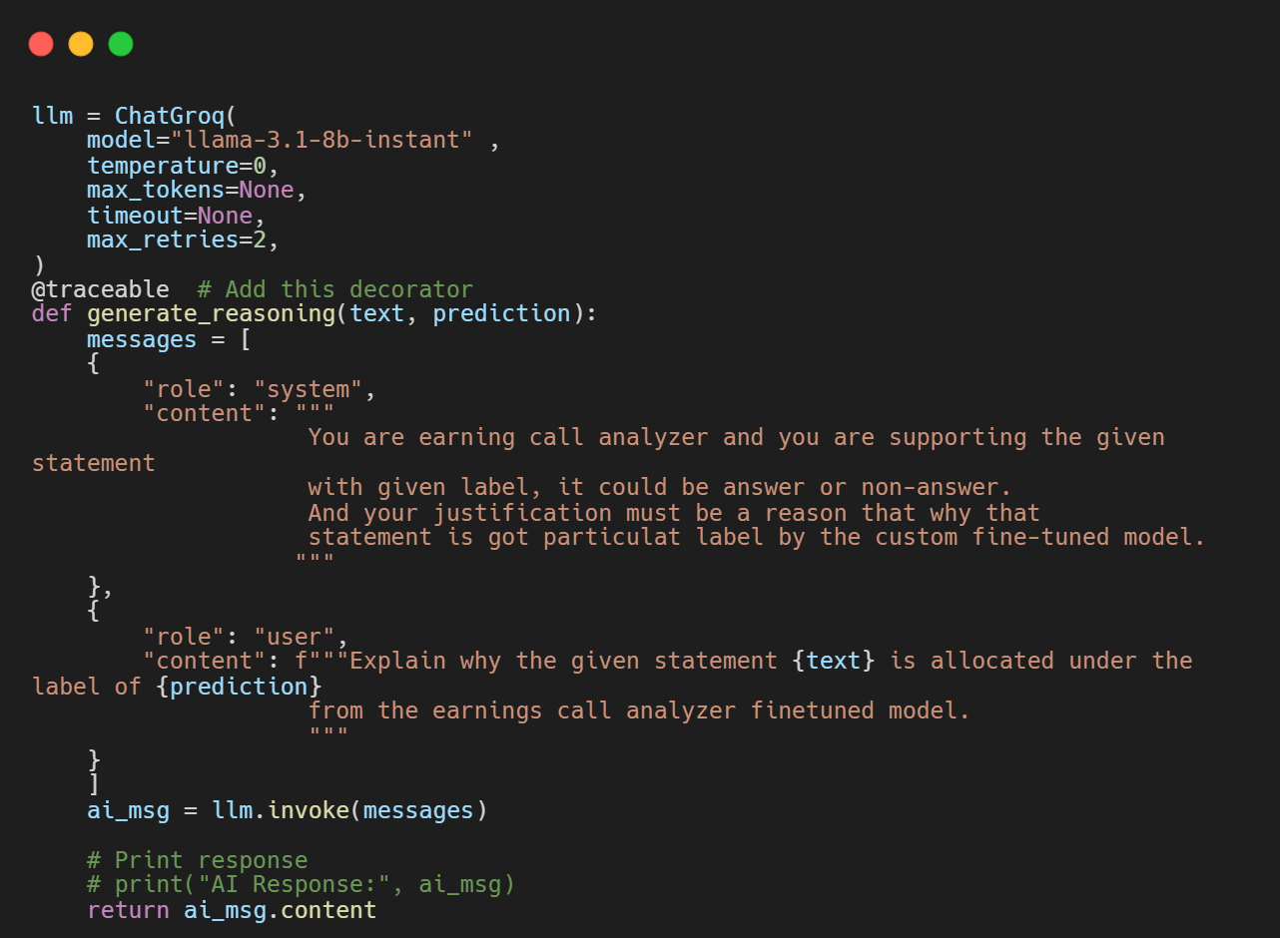
Reasoning with Llama-3.2-8B-Instant
Uses Llama 3.1 8B for generating reasoning.
Takes the classified label and generates a justification.
Ensures deterministic outputs with zero temperature.
Implemented with Groq API for fast inference.

Slide 10
Interface & Deployment
Deployment: Hosted on Streamlit for easy access.
Text Processing: Classifies text from full stop to full stop.
Visualization: Generates a pie chart showing the number of answers and non-answers.
Tabular Output: Displays classification results in a structured table format.
User Interface: Designed an intuitive UI for seamless interaction.
Real-time Inference: Provides instant classification and insights upon input.
Scalability: Handles multiple user requests efficiently.
Visit our model: https://team-fintech-mavericks.streamlit.app/

Slide 11
Suggestions for Improvement
Data Improvements
Increase dataset size for better generalization
Apply text augmentation to enhance diversity
Model Enhancements
Fine-tune only the last few layers for efficiency
Experiment with alternative architectures like T5 or BERT
Hyperparameter Tuning
Use learning rate scheduling for better convergence
Perform grid search or Bayesian optimization for tuning

Slide 12
Conclusion
Model Used:
Classification performed by a fine-tuned GPT-2 model.
Reasoning and explanation generated by Llama-3.2-8B-Instant.
Challenges & Limitations:
Model struggled with soft commitments and ambiguous responses.
Some misclassifications occurred due to subtle wording differences.
Future Work:
Deploy a backend API with LangSmith for continuous learning.
Improve dataset labeling and diversity for better generalization.

